Slide 1
IST687 – Applied Data Science
Chapter 13
Map MashUp

Slide 2

Data Science
Much of what we have accomplished so far has focused on the standard rectangular dataset: one neat table with rows and columns well defined. Yet much of the power of data science comes from bringing together difference sources of data in complementary ways. In this chapter we combine different sources of data to make a unique product that transcends any one source.

Slide 3
Data Science
Chapter Objectives
Demonstrate the integration of disparate data sources and formats producing a representative information model for decision making
Utilize ggplot for geographic map representation
Plot geographic and numerical data within one visualization

Slide 4
Data Science
Mashup
Anything that brings together disparate influences or elements
Relative to application development
Bringing together various sources of data to create a new product with unique value

Slide 5
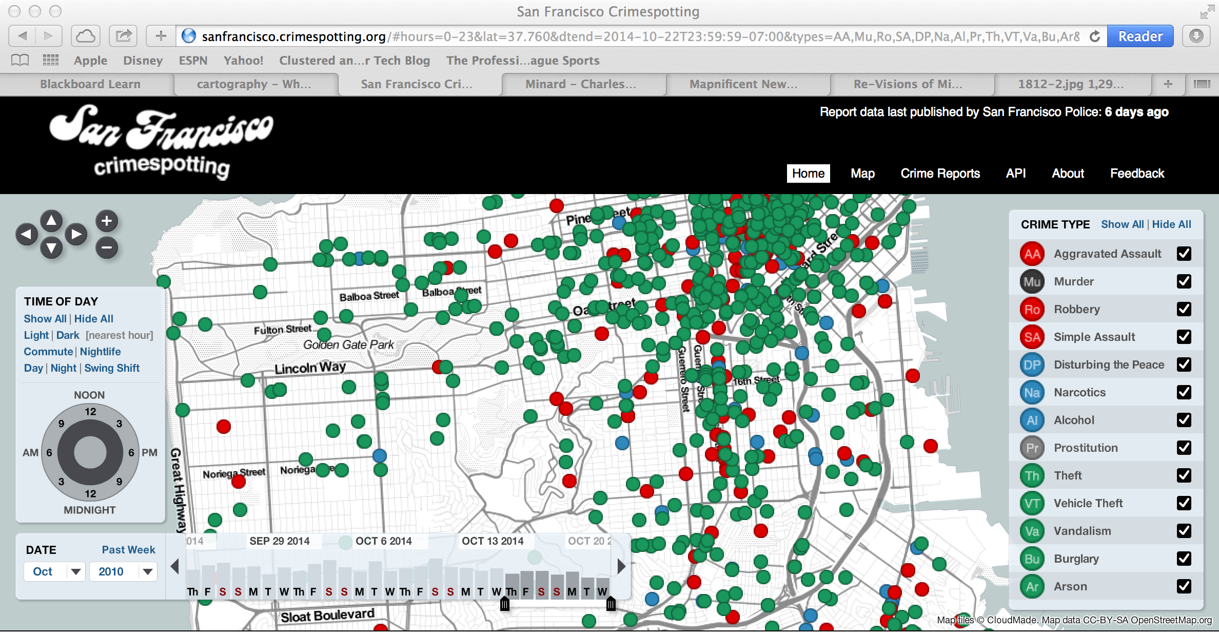
Data Science
http://sanfrancisco.crimespotting.org

Slide 6
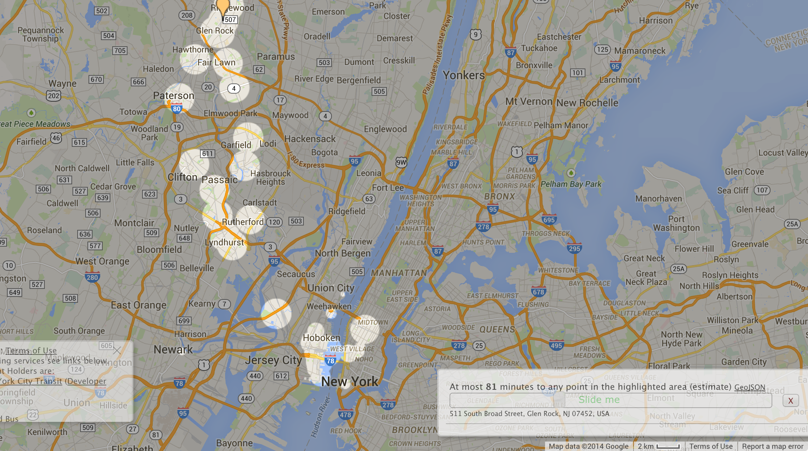
Data Science
http://www.mapnificent.net

Slide 7
Data Science
GGplot Map Key Concepts
map_data Get the data on the region to be mapped
geom_map How to render the map (ex. colors, heatmaps)
coord_map Make sure the map is not “stretched”

Slide 8
Data Science
GGplots
map_id is part of the AES Logical way to describe the data (ex. “new jersey”) Note that GGplot requires all lower case
Longitude and Latitude Can also add a specific physical location using geom_point – coordintes can be:
Hard coded
Via a conversion from logical to physical (ex. use JSON to access google api)

Slide 9
Data Science
Map Example
map_id is part of the AES Logical way to describe the data (ex. “new jersey”) Note that GGplot requires all lower case
Longitude and Latitude Can also add a specific physical location using geom_point – coordintes can be:
Hard coded
Via a conversion from logical to physical (ex. use JSON to access google api)

Slide 10
Data Science
GGplots
>dummyDF <- data.frame(state.name, stringsAsFactors=FALSE)
>dummyDF$state <- tolower(dummyDF$state.name)
→ Note state.name is data available within R (there is additional information available in the state dataset)
>us <- map_data("state")

Slide 11
Data Science
GGplots
> map.simple <- ggplot(dummyDF, aes(map_id = state))
> map.simple <- map.simple + geom_map(map = us, fill="white", + color="black")
> map.simple <- map.simple + expand_limits(x = us$long, y = us$lat)
> map.simple <- map.simple + coord_map() + ggtitle(“basic map of USA”)
> map.simple

Slide 12
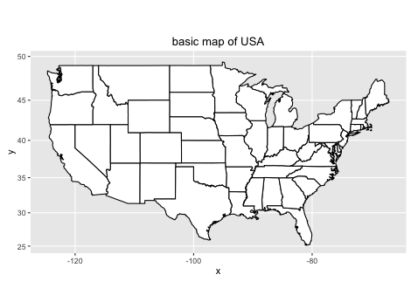
Data Science

Slide 13
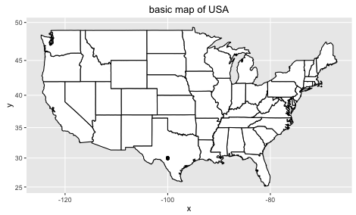
Data Science
map.simple + geom_point(aes(x = -100, y = 30))
Plotted point

Slide 14
Data Science
#Read in the states and make lower case
> dfStates <- readCensus()
> dfStates$state <- tolower(dfStates$region)
> map.popColor <- ggplot(dfStates, aes(map_id = state))
> map.popColor <- map.popColor + geom_map(map = us, aes(fill=july11pop))
> map.popColor <- map.popColor + expand_limits(x = us$long, y = us$lat)
> map.popColor <- map.popColor + coord_map() + ggtitle("state population")
> map.popColor

Slide 15
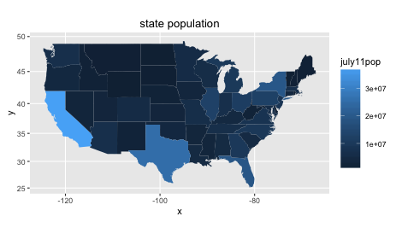
Data Science

Slide 16
Data Science
> latlon <- geocode("syracuse university, syracuse, ny")
Information from URL : http://maps.googleapis.com/maps/api/geocode/json?address=syracuse%20university,%20syracuse,%20ny&sensor=false
> latlon
lon lat
1 -76.13452 43.03857
→ Could have used addr2latlon function we previously created!

Slide 17
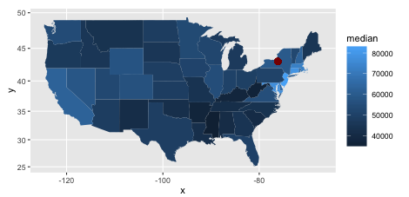
Data Science
>map.popColor + geom_point(aes(x = latlon$lon, y = latlon$lat), color="darkred", size = 3)
Plotted point

Slide 18
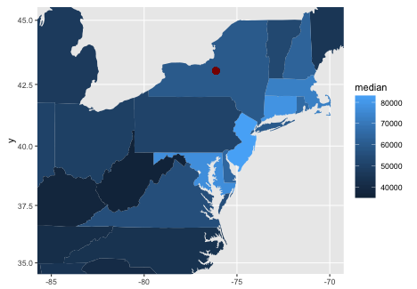
Data Science
> g <- map.popColor + geom_point( aes(x = latlon$lon, y = latlon$lat), color="darkred", size = 3)
> g + xlim(-85,-70) + ylim(35,45) + coord_map()
Plotted point

Slide 19
Data Science
Data on 10 Cities, dataset includes:
Name (City, State)
Business Rating (1-10)
Weather Rating (1-10)
Cost of Living Rating (1-10)
We want to map this info

Slide 20
Data Science
City | State | Business Rating | Weather Rating | Living Rating
Manhattan | NY | 10 | 5 | 7
Boston | MA | 7 | 3 | 6
Philadelphia | PA | 6 | 6 | 6
Tampa | FL | 5 | 7 | 7
Chicago | IL | 7 | 3 | 5
Boise | ID | 3 | 6 | 4
San Francisco | CA | 10 | 10 | 6
Seattle | WA | 7 | 7 | 8
Houston | TX | 5 | 2 | 2

Slide 21
Data Science
> cities <- c("Manhattan, NY", "Boston, MA", "Philadelphia, PA", "Tampa, FL", "Chicago, IL", "Boise, ID",
"San Francisco, CA", "Seattle, WA", "Houston, TX")
> bus <- c(10,7,6,5,7,3,10,7,5)
> weather <- c(5,3,6,7,3,6,10,7,2)
> living <- c(7,6,6,7,5,4,6,8,2)
> city.df <- data.frame(cities, bus, weather, living)
> city.df$state <- statesFake
> city.df$geoCode <- geocode(cities)

Slide 22

Data Science
> map.simple + geom_point(data=cities.df, aes(x = geoCode$lon, y = geoCode$lat))

Slide 23
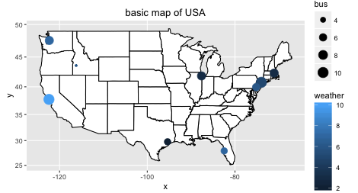
Data Science
Have the marker size and color represent business ranking and weather
> map.simple + geom_point(data=city.df, aes(x = geoCode$lon, y = geoCode$lat, size=bus, color=weather))

Slide 24
IST687 – Applied Data Science
End of Chapter 13 Lecture
Map MashUp

